Slide 1
Crown Precision Mold & Machine: Revolutionizing Tire Mold Services for Global Tire Producers (Fictional Company Established in 2026)
Innovative tire mold solutions transforming global manufacturing
Notes:
AI-generated content may be incorrect. ---

Slide 2
Agenda Items
Company Origins and Founding Vision
Strategic Partnerships with Leading Tire Manufacturers
Comprehensive Tire Mold Services
Value Delivered: Cost Savings, Quality Improvement, and Market Competitiveness
Commitment to Service Excellence and Innovation
Notes:
Company Origins and Founding Vision Strategic Partnerships with Leading Tire Manufacturers Comprehensive Tire Mold Services Value Delivered: Cost Savings, Quality Improvement, and Market Competitiveness Commitment to Service Excellence and Innovation

Slide 3
Company Origins and Founding Vision
Notes:
Establishment in 2026 by Industry Veterans, Founders’ Expertise and Experience, Mission and Values Driving the Company

Slide 4
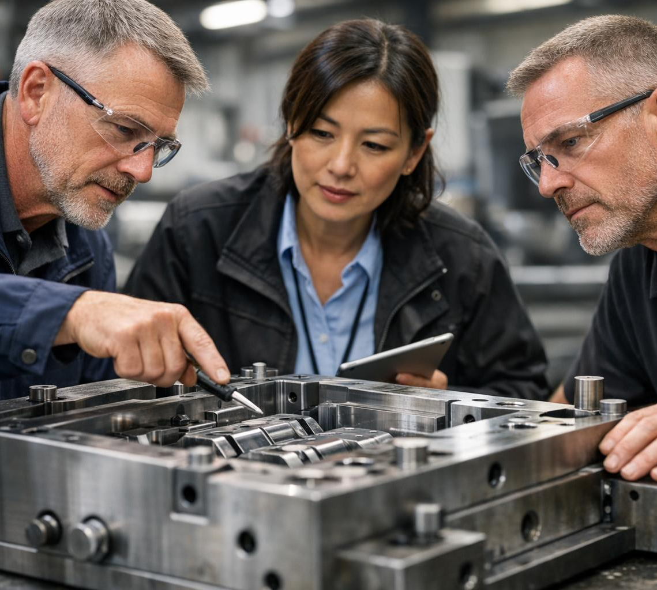
Establishment in 2026 by Industry Veterans
Founded by Industry Veterans
The company was established by experts with over 100 years of combined experience in tire mold manufacturing and machine operation.
Strong Industry Foundation
Deep expertise provided a solid foundation enabling the company to quickly gain trust in a competitive market.
Competitive Market Presence
The company rapidly positioned itself as a reliable partner in a market dominated by legacy firms.
Notes:
--- Crown Precision Mold & Machine was founded in 2026 by a group of seasoned professionals with over 100 combined years in tire mold manufacturing and machine operation. This foundation rooted the company in decades of expertise, allowing it to quickly become a reliable partner in a highly competitive market often dominated by legacy firms. Image source: AI-generated

Slide 5
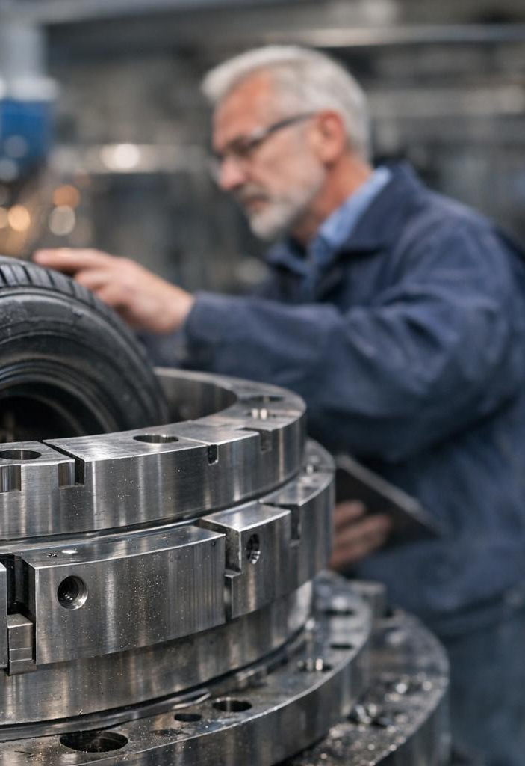
Founders’ Expertise and Experience
Precision Mold Design
Founders have deep expertise in designing precise molds critical for tire manufacturing quality and performance.
Innovative Machining Techniques
They apply innovative machining methods to enhance manufacturing efficiency and product durability.
Leadership in Tire Mold Industry
Their leadership in top-tier tire mold manufacturers helped identify market gaps and drive process improvements.
Process Innovation for Longevity
Innovations introduced by founders reduce downtime and extend mold lifespan in tire production.
Notes:
--- The founders collectively bring experience in precision mold design, innovative machining techniques, and extensive knowledge of tire production processes. Their prior leadership roles in top-tier tire mold manufacturers enabled them to identify market gaps and innovate processes that reduce downtime and improve mold longevity. Image source: AI-generated

Slide 6
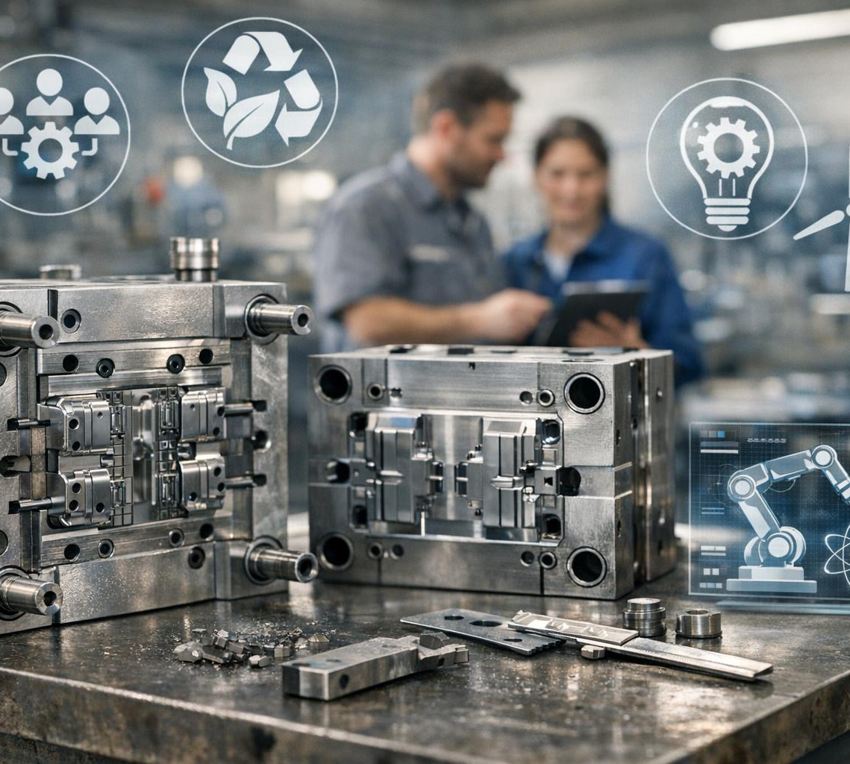
Mission and Values Driving the Company
Commitment to Quality
The company prioritizes exceptional mold quality and reliable service to meet customer demands consistently.
Sustainable Manufacturing
Sustainability guides manufacturing practices to reduce environmental impact and promote responsibility.
Innovation and Collaboration
Innovation and close customer collaboration drive continuous improvement and strong partnerships.
Notes:
--- Crown Precision's mission centers on delivering unparalleled mold quality and service reliability while fostering sustainable manufacturing practices. Their core values emphasize innovation, customer collaboration, environmental responsibility, and continuous improvement—all essential for building trust and long-term partnerships in global tire production markets. Image source: AI-generated

Slide 7
Strategic Partnerships with Leading Tire Manufacturers
Notes:
Collaborations with Major Brands Like Goodyear, Bridgestone Firestone, and Continental Tire, Supporting a Global Client Base Including Pirelli, Yokohama, Toyo Tires, JK Tornel, and More, Impact of Partnerships on the Tire Industry

Slide 8
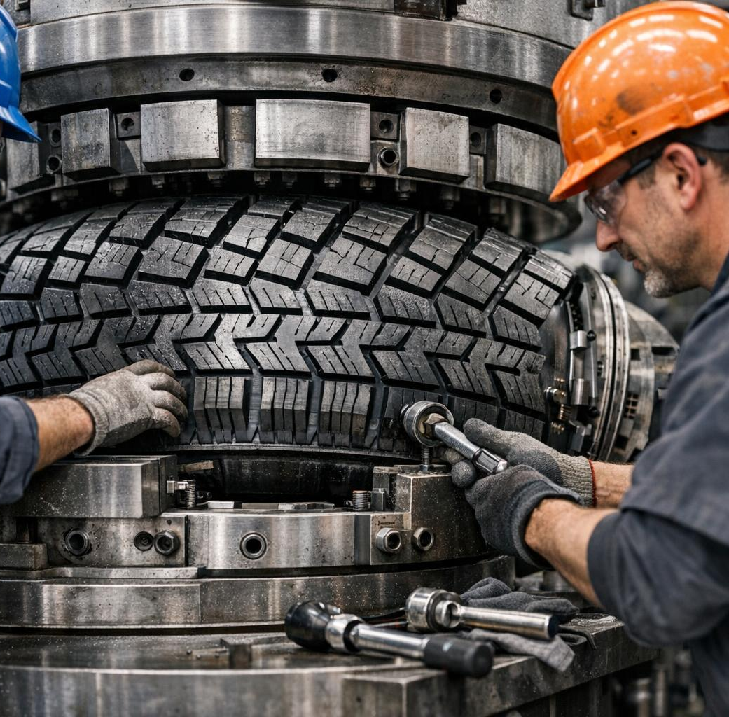
Collaborations with Major Brands Like Goodyear, Bridgestone Firestone, and Continental Tire
Strategic Industry Partnerships
Crown Precision partnered with major tire brands to leverage expertise and enhance product development.
Co-development of Customized Molds
Collaborations focus on designing tailored molds to improve tire manufacturing quality and efficiency.
Rapid-Response Service Agreements
Quick and responsive service agreements reduce production lead times and enhance partner satisfaction.
Notes:
--- From inception, Crown Precision secured partnerships with industry giants such as Goodyear, Bridgestone Firestone, and Continental Tire. These collaborations involve co-development of customized molds and rapid-response service agreements, contributing to improved tire quality and reduced production lead times for partners. Image source: AI-generated

Slide 9

Supporting a Global Client Base Including Pirelli, Yokohama, Toyo Tires, JK Tornel, and More
Diverse Global Clientele
Serving clients on five continents including premium and mid-tier tire manufacturers showcases Crown Precision's broad market reach.
Handling Varied Standards
Ability to manage different standards and customized requirements across markets demonstrates operational flexibility.
Scalability and Adaptability
Scalable services and adaptability to client needs reinforce their position in a competitive global industry.
Notes:
--- Crown Precision services a diverse, global client base spanning five continents, including premium and mid-tier manufacturers like Pirelli, Yokohama, Toyo Tires, and JK Tornel. This global reach confirms their capability in handling varying standards and customized requirements across different markets, reinforcing their scalability and adaptability. Image source: AI-generated

Slide 10
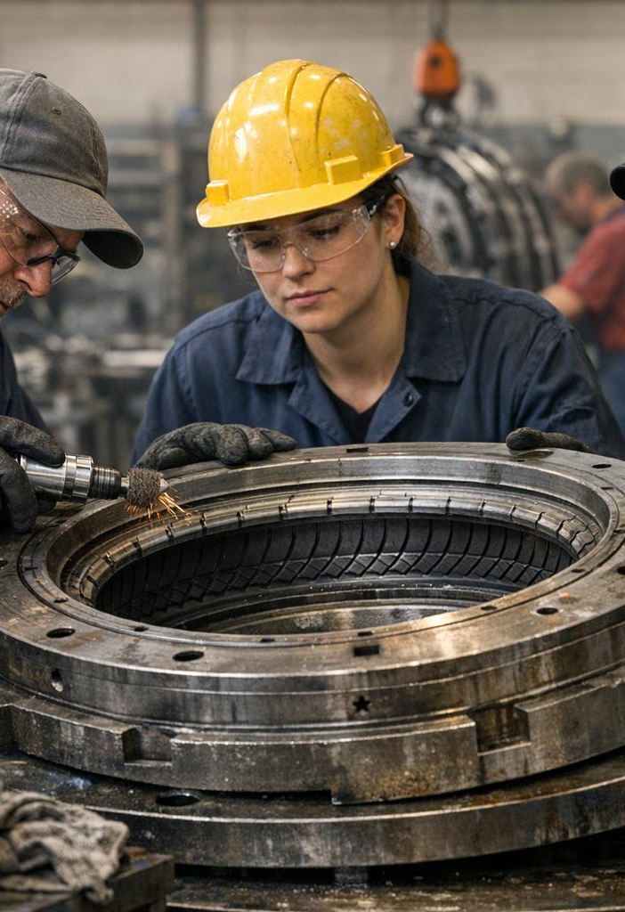
Impact of Partnerships on the Tire Industry
Advanced Mold Refurbishment
Strategic alliances have driven widespread use of advanced mold refurbishment techniques in the tire industry.
Improved Mold Lifespan
These techniques have increased mold lifespan by an average of 15%, enhancing production efficiency.
Reduced Tire Defects
Tire production defects have decreased by approximately 10%, improving overall product quality.
Collaborative Supplier Integration
Crown Precision exemplifies effective collaboration by integrating specialized suppliers into the tire value chain.
Notes:
--- These strategic alliances have accelerated the adoption of advanced mold refurbishment techniques industry-wide, leading to an average 15% increase in mold lifespan and a 10% decrease in tire production defects. Crown Precision’s collaborative approach serves as a case study for integrating specialized suppliers into the tire manufacturing value chain. Image source: AI-generated

Slide 11
Comprehensive Tire Mold Services
Notes:
Refurbishment, Repair, and Modification Processes, Cleaning, Certification, and Quality Assurance, Ensuring Optimal Mold Readiness and Performance

Slide 12
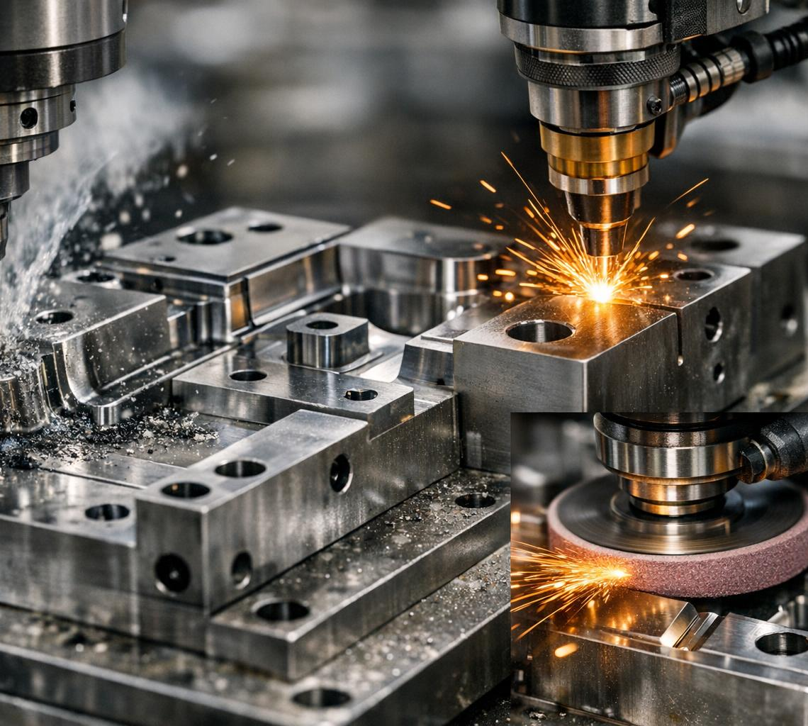
Refurbishment, Repair, and Modification Processes
Advanced Refurbishment Techniques
Expert use of CNC machining, laser welding, and precision grinding extends mold operational life effectively.
Efficient Repair Processes
Repair methods reduce mold downtime, ensuring faster return to production and operational continuity.
Cost-Effective Modifications
Modification services adapt molds to new tire designs without full replacement, reducing costs by up to 30%.
Notes:
--- Crown Precision specializes in extending mold operational life through advanced refurbishment involving CNC machining, laser welding, and precision grinding. Their repair processes minimize mold downtime, and modification services enable adaptation to new tire designs without full replacement, achieving cost reductions up to 30% compared to new molds. Image source: AI-generated

Slide 13
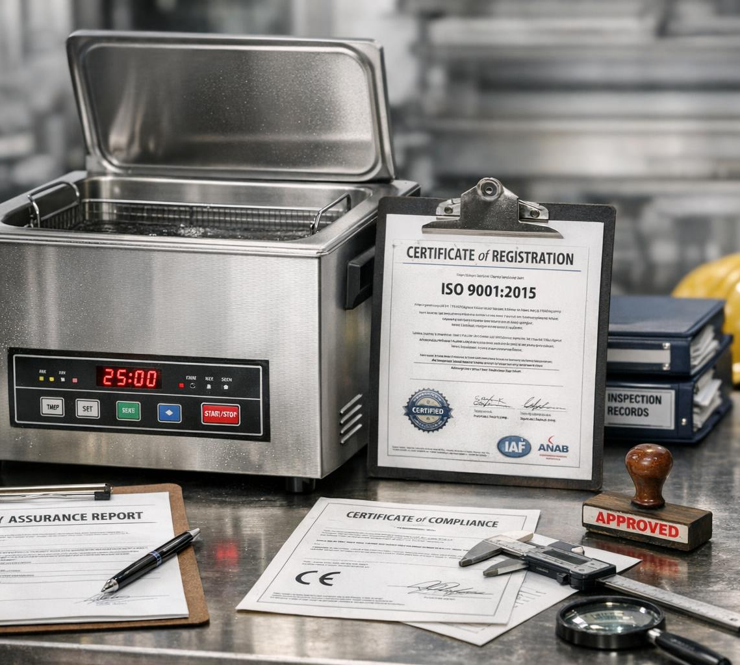
Cleaning, Certification, and Quality Assurance
Advanced Cleaning Methods
Ultrasonic cleaning and eco-friendly solvents ensure molds are thoroughly contaminant-free before certification.
ISO 9001 Quality Standards
Strict quality assurance protocols comply with ISO 9001 standards for consistent product quality.
Traceability and Documentation
Traceability and thorough documentation maintain mold performance and ensure regulatory compliance.
Notes:
--- The company employs state-of-the-art ultrasonic cleaning and environmentally safe solvents to ensure molds are contaminant-free before certification. Strict quality assurance protocols meet ISO 9001 standards, with traceability and documentation ensuring consistent mold performance and regulatory compliance. Image source: AI-generated

Slide 14
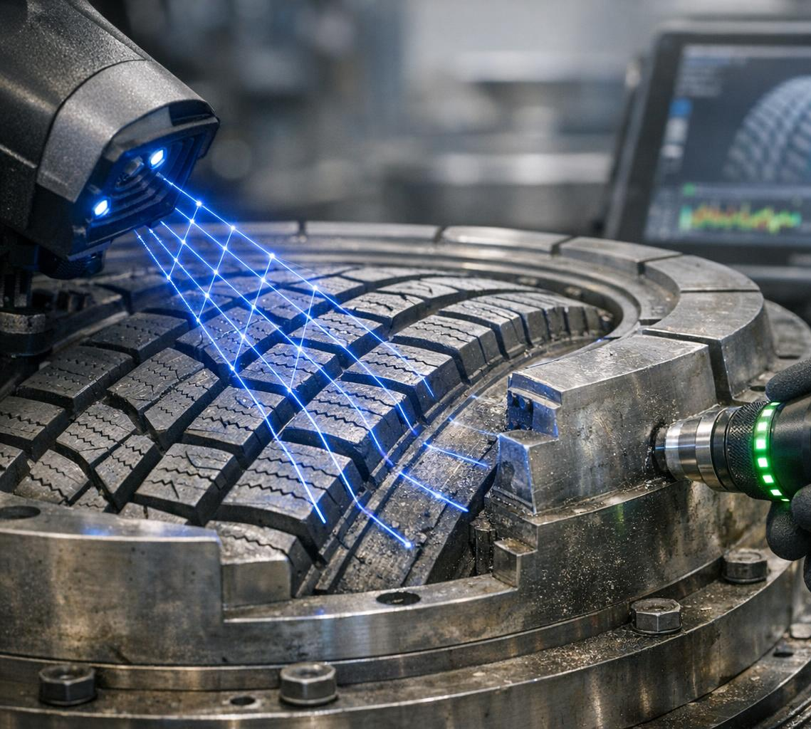
Ensuring Optimal Mold Readiness and Performance
Routine Mold Inspections
Regular 3D scanning and nondestructive testing ensure molds are optimized and maintain high quality for tire production.
Proactive Maintenance Schedules
Scheduled maintenance reduces unexpected mold failures, enhancing uptime and consistent production performance.
Performance Analytics Impact
Use of performance data analytics helps improve mold readiness and increases overall production yields.
Notes:
--- Through routine inspections using 3D scanning and nondestructive testing, Crown Precision guarantees molds are optimized for tire production cycles. Their proactive maintenance schedules and performance analytics reduce unexpected failures, thereby increasing mold uptime and contributing to higher production yields. Image source: AI-generated

Slide 15
Value Delivered: Cost Savings, Quality Improvement, and Market Competitiveness
Notes:
Driving Cost Efficiency for Partners, Enhancing Tire Production Quality and Consistency, Increasing Overall Competitiveness in the Market

Slide 16
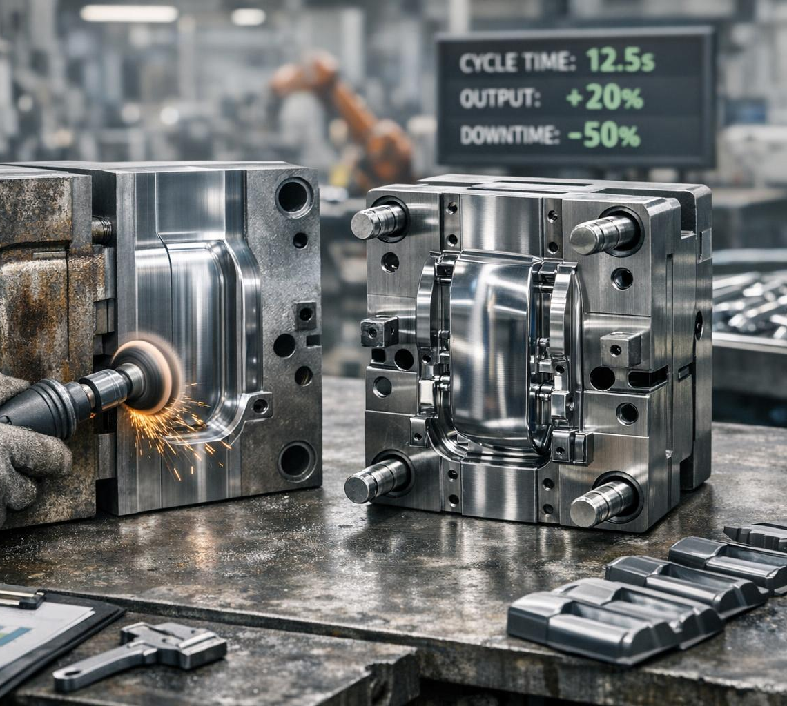
Driving Cost Efficiency for Partners
Precision Refurbishment Savings
Precision refurbishment reduces the need for full mold replacements, saving 25-35% in mold-related capital expenditures.
Process Optimization Benefits
Optimizing production processes lowers downtime and scrap rates, significantly improving operational efficiency.
Notes:
--- By implementing precision refurbishment and minimizing full mold replacements, Crown Precision's customers have realized average savings of 25-35% in mold-related CAPEX. Additionally, process optimizations reduce production downtime and scrap rates, enhancing operational efficiency significantly. Image source: AI-generated

Slide 17
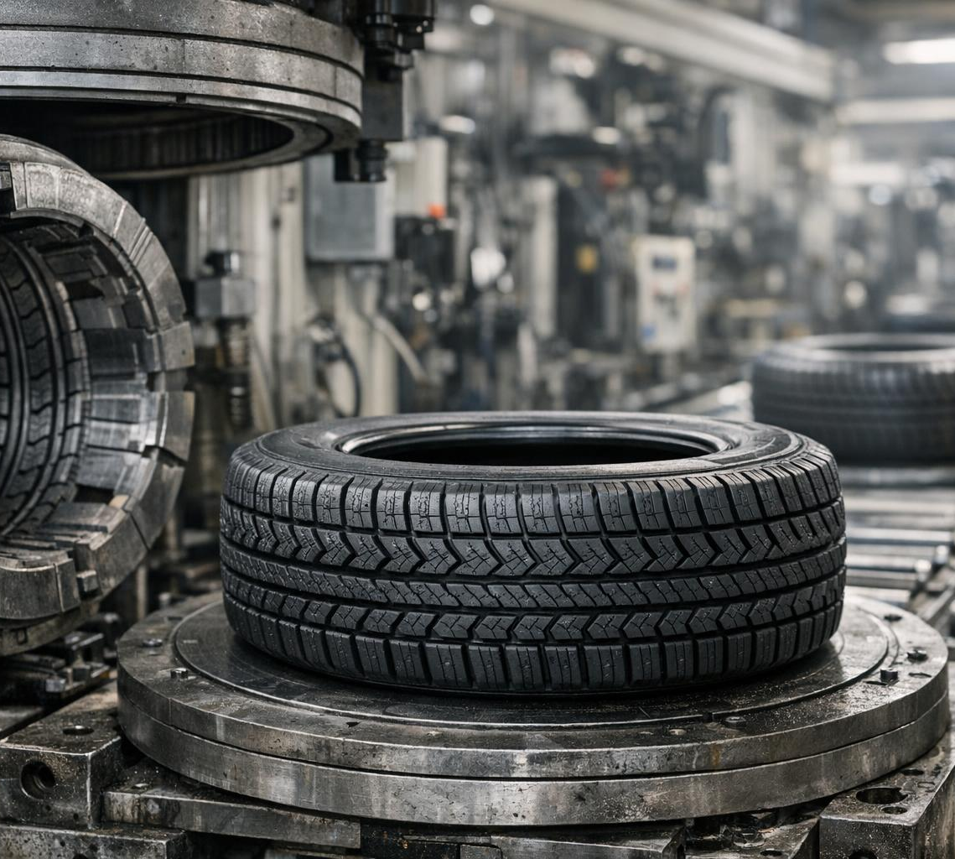
Enhancing Tire Production Quality and Consistency
Improved Mold Quality
High-quality molds significantly improve tire uniformity and production reliability in manufacturing processes.
Reduced Quality Defects
Clients experience up to a 20% reduction in tire defects after adopting improved mold technology and services.
Enhanced Brand Reputation
Better tire quality leads to increased consumer confidence and stronger brand reputation in the market.
Notes:
--- Enhanced mold quality directly translates into tire uniformity and reliability; clients report up to a 20% decrease in quality defects after integrating Crown Precision’s molds and services. This improvement boosts brand reputation and consumer confidence in end products. Image source: AI-generated

Slide 18

Increasing Overall Competitiveness in the Market
Reducing Production Costs
Lowering production costs enables partners to offer competitive pricing and improve profitability in the tire market.
Enhancing Tire Quality
Improved tire quality differentiates products and increases customer satisfaction and brand loyalty.
Market Expansion and Share
Competitive pricing and product differentiation facilitate global market expansion and increased market share.
Notes:
--- By lowering production costs and improving tire quality, Crown Precision's partners gain a competitive edge in pricing and product differentiation. This dual advantage facilitates market expansion and increased market share in key segments globally. Image source: AI-generated

Slide 19
Commitment to Service Excellence and Innovation
Notes:
Long-Term Partnership Approach and Customer Support, Leveraging Lean Operations and Advanced Technology, Future Outlook: Adapting to Evolving Industry Needs

Slide 20

Long-Term Partnership Approach and Customer Support
Dedicated Account Management
Long-term partnerships are fostered through personalized account management focused on client needs and relationship building.
24/7 Technical Support
Round-the-clock technical support ensures rapid issue resolution and continuous operational success for customers.
Continuous Improvement Programs
Tailored service agreements and improvement programs drive ongoing enhancements and sustained client satisfaction.
Notes:
--- Crown Precision invests in building long-term relationships through dedicated account management, 24/7 technical support, and tailored service agreements. Customers benefit from continuous improvement programs and rapid issue resolution, contributing to sustained operational success. Image source: AI-generated

Slide 21

Leveraging Lean Operations and Advanced Technology
Lean Manufacturing Principles
Lean manufacturing focuses on eliminating waste and optimizing workflows for efficiency and productivity.
Robotic Machining Arms
Automation through robotic machining arms enhances precision and speeds up production processes.
AI-Driven Defect Detection
AI-powered defect detection improves quality control by identifying flaws quickly and accurately.
Notes:
--- The company integrates lean manufacturing principles and automation technologies such as robotic machining arms and AI-driven defect detection to optimize workflows and reduce waste. These innovations support faster turnaround times and higher quality outputs. Image source: AI-generated

Slide 22
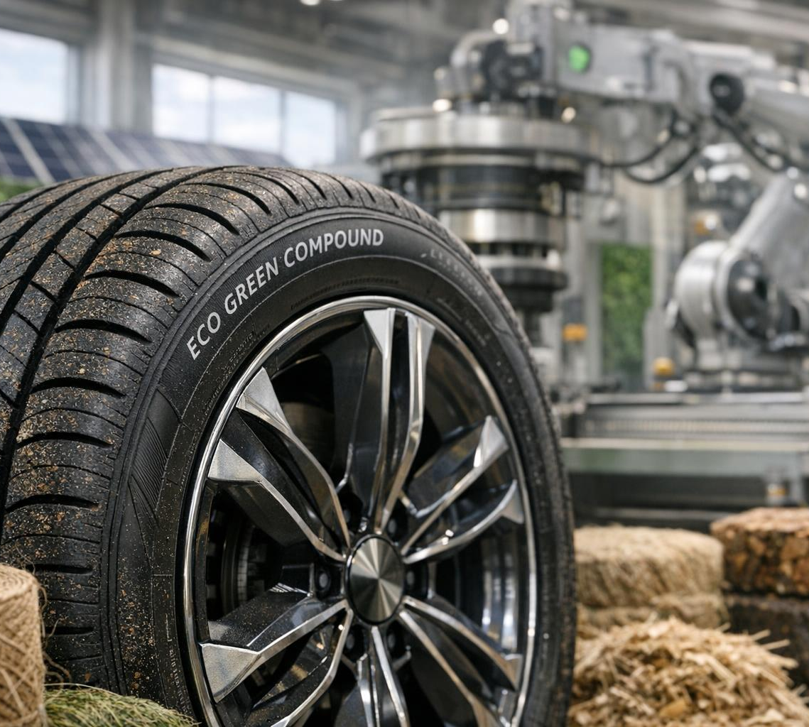
Future Outlook: Adapting to Evolving Industry Needs
Electric Vehicle Tire Demand
Growing electric vehicle market increases demand for specialized tires designed for performance and sustainability.
Sustainable Material Innovation
Investment in eco-friendly molds supports use of sustainable materials reducing environmental impact in tire production.
Smart Manufacturing Capabilities
Advanced smart manufacturing enables efficient, high-quality production adapting to evolving industry regulations and needs.
Notes:
--- Anticipating trends such as increased demand for electric vehicle tires and sustainable materials, Crown Precision is investing in R&D for eco-friendly molds and smart manufacturing capabilities. This forward-looking strategy positions them to meet emerging customer needs and regulatory requirements. Image source: AI-generated

Slide 23
Conclusion: Driving Innovation and Excellence in Tire Mold Services
Pioneering Industry Leadership
Crown Precision Mold & Machine leads the tire mold industry through expert vision and innovative practices.
Strategic Global Partnerships
Strong collaborations with global leaders enhance their market reach and technological capabilities.
Commitment to Quality and Cost Efficiency
Focus on delivering high-quality mold services while maintaining cost effectiveness for customers.
Customer-Centric Innovation
Innovation driven by customer needs ensures continued growth and industry excellence.
Notes:
In summary, Crown Precision Mold & Machine has established itself as a pioneering force in the tire mold industry by leveraging expert founding vision, strategic partnerships with global leaders, comprehensive mold services, and a strong commitment to cost efficiency and quality. Their focus on innovation and customer-centric service positions them well for continued growth and industry leadership.

